Slide 1
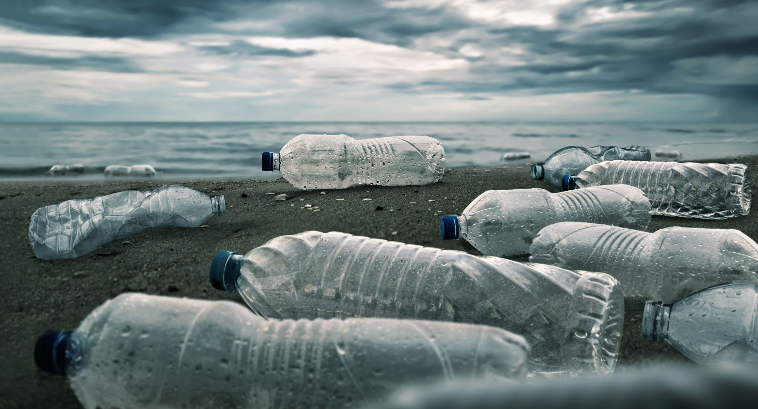
Goal Research Project: Combatting Plastic Waste Pollution
Design Thinking & Cognitive Approach to Environmental Sustainability
3rd Year Undergraduate Research Task
Team 4 : Mindsparks

Slide 2
Design Thinking Process Map
Inputs
(Data + Feedback)
Empathize
Define
Ideate
Prototype
Test
Outputs
Solutions

Slide 3
Scope
Students begin by understanding a real-world scientific or environmental problem through observation, literature review, or interaction with stakeholders.
Examples:
Plastic waste Management
Energy consumption in the college campus
Waste management in the community
Biodiversity loss in nearby ecosystems
Cognitive Thinking Level
Remembering: Identifying basic scientific concepts related to the problem.
Understanding: Explaining causes, impacts, and background information.
Scope Identification
Nature of the problem
Environmental or scientific relevance
Existing knowledge and studies

Slide 4
Empathy
Teachers Point of View
How learners will understand the problem?
What will be the point of concern wHILE studying the research project?
How much time will be taken by students for solving or completing the problem?
What resources should be provided for the project?

Slide 5
Empathy
For Students
What difficulties did you face while surveying the problem?
How do we know if the topic is researchable and relevant?
Is selected topic related to our practical experiments or field work?
How narrow or broad should the research topic be?
What are the challenges and opportunities in plastic waste management?

Slide 6
Define (Problem Definition)
Observations
Pain Points
Problem Statement
How Might We Question
Objective: Understand the human impact of plastic pollution
Conduct interviews with sanitation workers and residents
Observe waste disposal behavior in the community
Create stakeholder persona profiles
Cognitive Focus: Observation, empathy mapping, contextual understanding

Slide 7

Ideate (Generating Solutions)
Objective: Generate diverse and creative ideas
Brainstorm circular economy strategies
Develop technological solutions such as AI-based waste sorting apps
Design gamified recycling stations
Cognitive Level: Divergent thinking and creativity

Slide 8
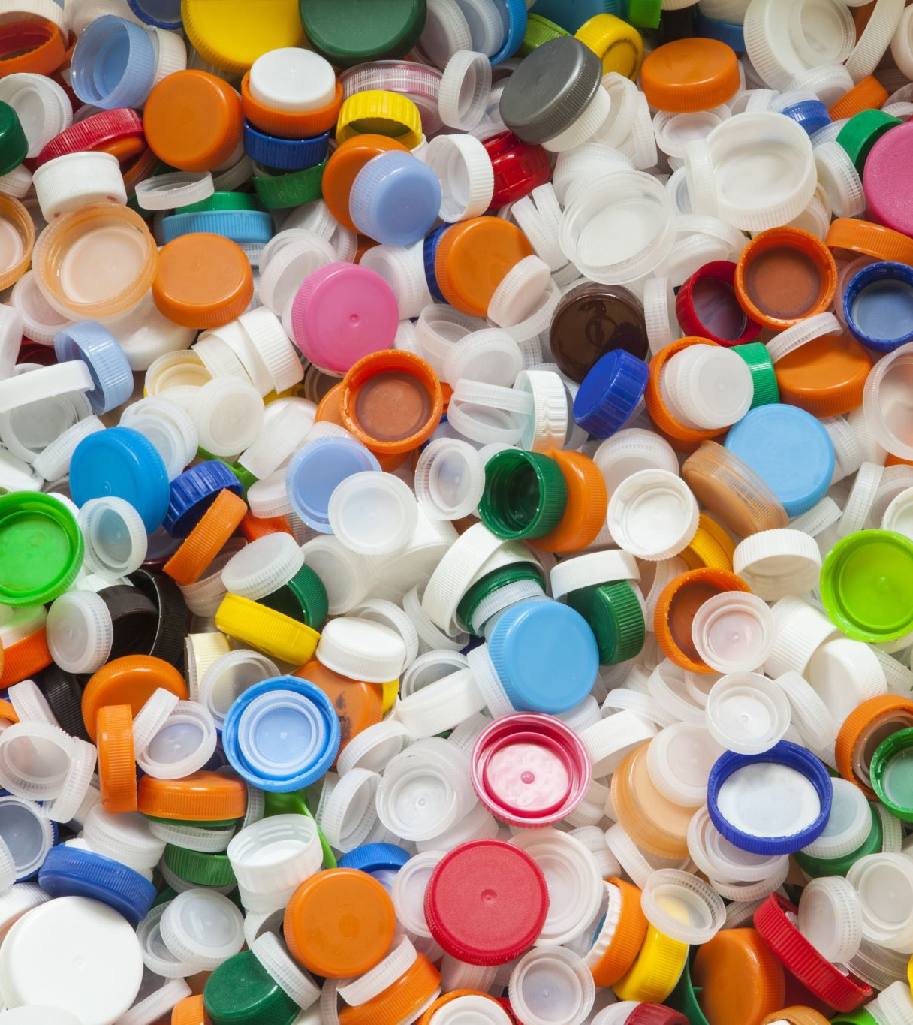
Prototype (Developing Solutions)
Build low-fidelity models of proposed solutions
Examples: Smart recycling bin model or waste management app wireframe
Prototype allows quick testing of ideas
Rule: Always present ideas with a prototype

Slide 9
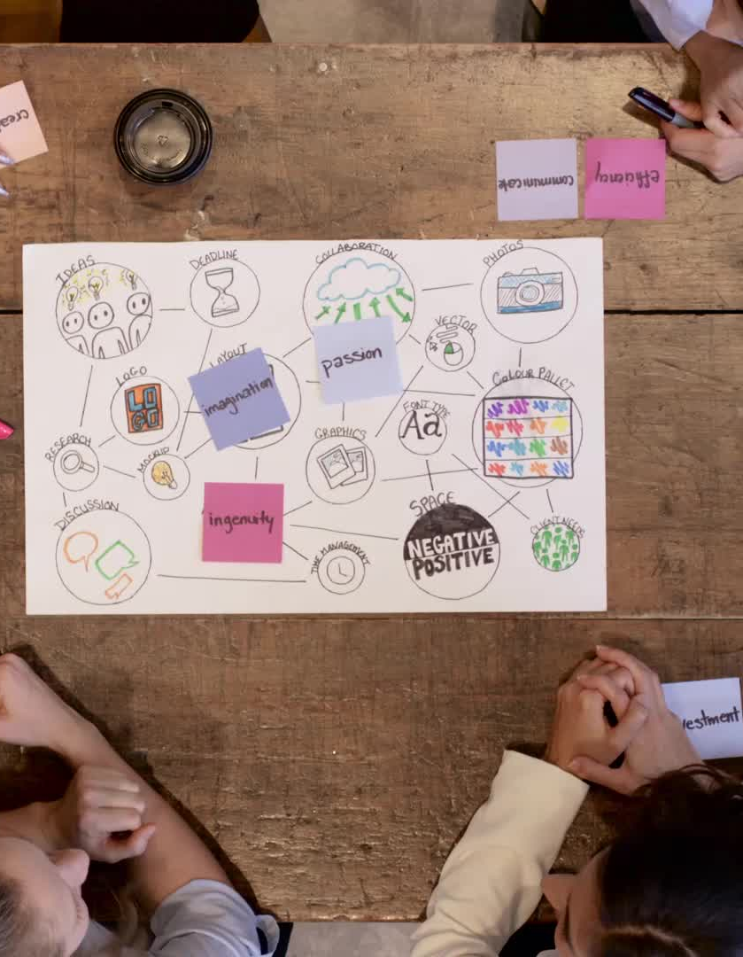
Phase 5 – Test (Evaluation and Feedback)
Present prototype to target users
Collect feedback from community members
Analyze strengths and weaknesses
Iteratively improve the solution
Cognitive Level: Critical evaluation

Slide 10
Case Study – Versova Beach Cleanup
One of the largest beach cleanups in the world
Community-led initiative that removed thousands of tons of plastic waste
Demonstrates real-world impact of collaborative environmental action
Highlights importance of citizen participation

Slide 11

Conclusion & Call to Action
Research should focus on designing practical solutions
Design Thinking enables creative environmental problem-solving
Next Step: Pilot test prototype on university campus or local community
Encourage sustainable habits and community engagement

Slide 12
The Cognitive Framework- Assessment and Evaluation
Remembering & Understanding: Identify plastic types (PET, HDPE) and degradation rates
01
Applying & Analyzing: Map local pollution hotspots using environmental data
02
Evaluating: Critically assess existing waste management policies
03
Creating: Develop innovative solutions using Design Thinking
04

Slide 13
Thank you

